Slide 1
Spiccato: Mystery or Science?
Helga Winold, Esther Thelen, Jing Feng

Slide 2
Helga Winold, DMA
Professor Emeritus, Indiana University
President's Award for Distinguished Teaching
Inspiration for this research Heifetz
Path: Kinesiology -> Esther Thelen

Slide 3
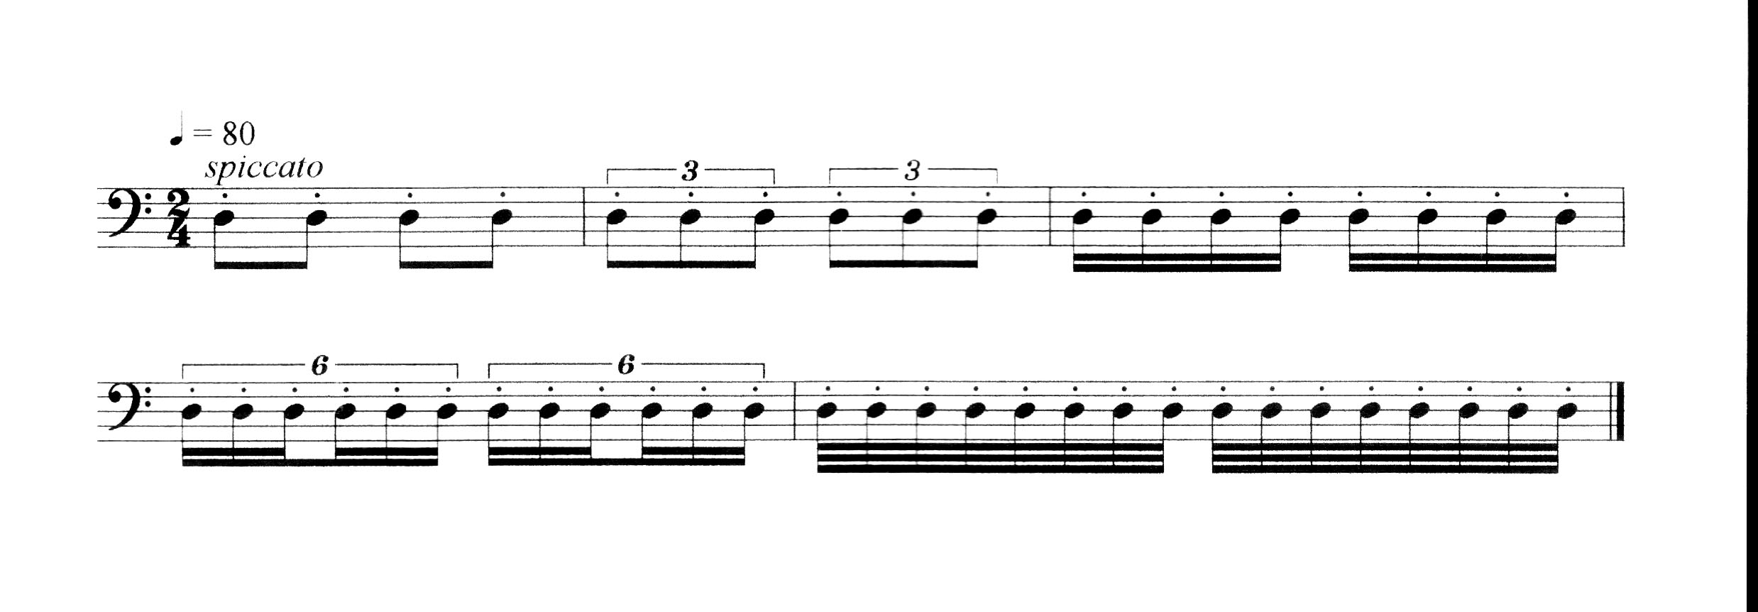

Slide 4
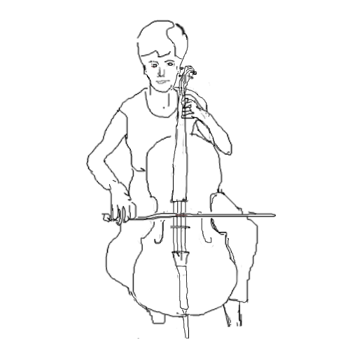
shoulder angle
x
elbow angle
y
z
wrist angle
downbow
upbow
frog
tip

Slide 6
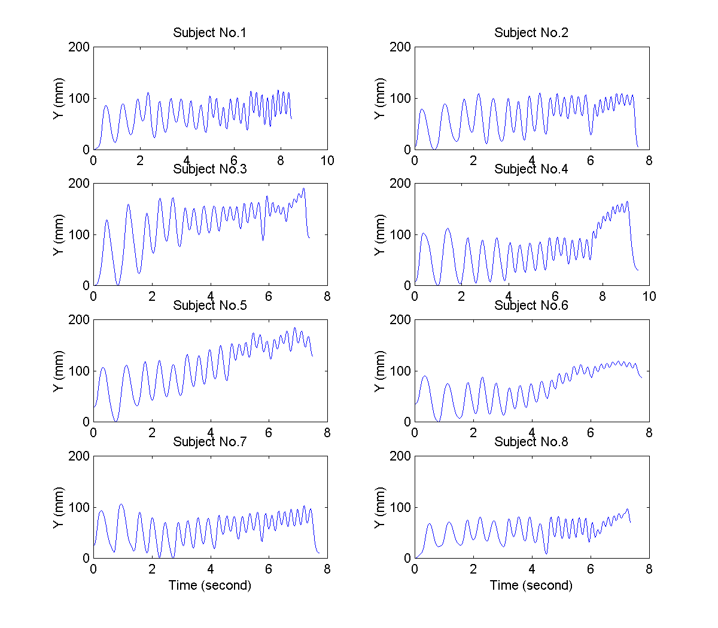
At first glance, they are very similar

Slide 7
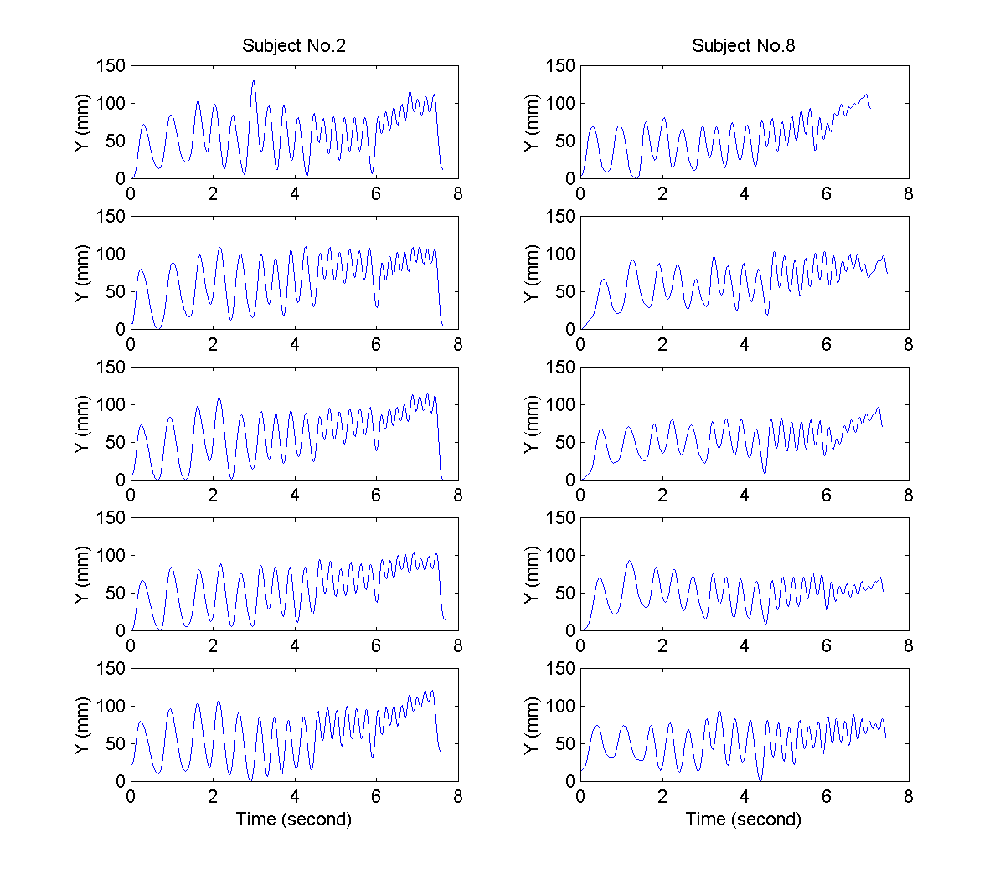
Professional vs student whole arm movement

Slide 8
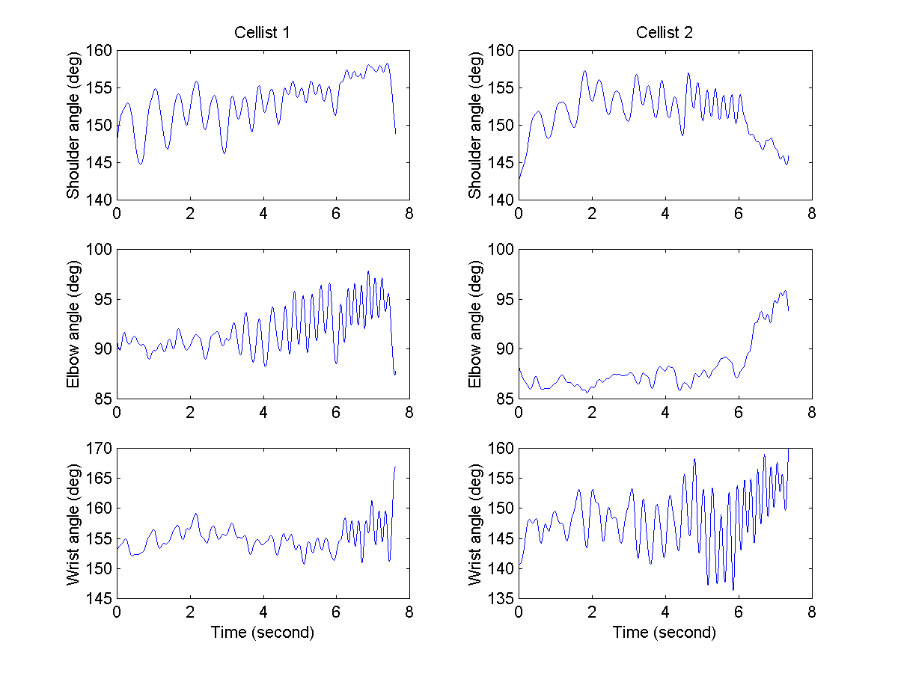
Professional vs student looking at different joints

Slide 9
Joint angles

Slide 10
Professional vs. student: velocity
Cellist 2
Cellist 8

Slide 11
Why research matters
Naked eye: most string players can’t discern differences in movement
Players not using all their joints are prone to pain and injury
Analysis of movement could be helped with scientific research
Research could help with injury prevention in practice and teaching

